Slide 1
Clothing & Textiles’ Source Sampling Program For Dress and Heraldics
14 April 2021

Slide 2
Overview
Background – How did we get here?
Terminology – What does DLA Troop Support expect?
Contractual Obligation – Why should we care
General Procedures – How it all works
Source:

Slide 3
Product Test Center Analytical History What Has Happened In the Last 102 years!
Lab established in 1919 at Philadelphia QM Depot where testing was for paints and oils
By 1927 the mission refocused to test textiles, rubber, shoes, metals, leather and paper for strength and colorfastness, and other physical and chemical testing.
In 1941 a new building was constructed, and served as a focal point for R&D and testing of textile materials
In 1946 the lab was used by the QM Inspection service for sample testing
In the 1950’s the lab tested thermal properties on cold weather gear for Korea, and worked to develop a water-repellant shoe method, along with anti fungal research on tropical textile goods.
In 1953 the R&D work moved to Natick, and the Philadelphia lab became a conformance laboratory.
In the 1970’s DPSC’s Analytical Testing Laboratory became a member of the DLA’s Independent Laboratory Testing Team, and was able to offer its testing services to other government agencies in all types of chemical and physical analysis
From 1996 to 2017 we were part of al all PTC directorate under Land & Maritime, now part of Troop Support
The PTC-Analytical is available to support all of Troop Support’s supply chains and other MSC’s, service partners, and outside government agencies.
We are here to help with all of your testing needs (there are a lot of them)!
Notes:
The PTC’s main concern and work over the years has focused on supporting the warfighter through conformance testing. Along with supporting the MSCs we also support the services, WoG, and are able to test for non-government contractors

Slide 4
PTC-A Value Added
Value Of Testing
Ensures Product Conformance
Mitigates the Risk of Counterfeit goods entering Supply Chains
Reduces Customer Complaints
Reduces Material Cost / Identifies Questionable Sources
Advantages of the PTC
Test and support to DLA customers is non-reimbursable
Integrated into overall TQ program
Studies demonstrate best value to the agency
Record of excellent support throughout DLA
Our Lab is ISO Registered, ISO 9001-2015
Provide Professional and Cost Effective Testing Services
Notes:
Our purpose as a testing facility is of course to provide professional and cost effective testing services. Through our work in all labs we strive to stay on the cutting edge, and be aware of new advances in testing. New equipment, and training are planned well in advance of items moved to DLA for sustainment.

Slide 5
Background
1980s
1991
1990s
2002
2010s
Submit 1 in 10 lots to C&T laboratory
Lot failed → Unreliable Status
3 consecutive lots to exit Unreliable Status
Contractors chose to wait and did NOT ship goods
Source:
Notes:
In the 1980’s there was just testing, no one shipped goods based on their own testing results. There was fear of being put in an unreliable status, this caution caused backlogs and delays.

Slide 6
Background
1980s
1991
1990s
2002
2010s
Source Sampling Program begins
Government reviews test reports
No regular verification schedule
Contractor’s test results primary
Goal → Reduce contractor’s delayed shipments
Source:
Notes:
In 1991 the source sampling era began, contractors were able to ship on their own test reports, reducing backorders.

Slide 7
Background
1980s
1991
1990s
2002
2010s
Clothing & Textiles asks the Product Test Center to take over the Source Sampling Program
DPSCM 4155.3 and contracts not updated to reflect change
2018 DPSCM 4155.3 updated to AQAR
Source Sampling MOA between C&T and PTC signed in 2019
Source:
Notes:
C&T’s delegation of the source sampling program to the PTC was not documented until 2019.

Slide 8
The AQAR Is Your Friend!
The AQAR serves multiple purposes for DLA
It allows us to have oversite into our vendors quality process without having to be present in their manufacturing plants
Quality process and quality goods are something that DLA is purchasing along with the cloth, buttons, boots, helmets and anything else the warfighter wears or carries. If a vendor is not in compliance they are cheating us.
Is that fraud? It may be, but it also may not come to that level if they do not understand what is expected or what their responsibilities are
This type of compliance can be audited.
Notes:
Vendors seem to pay more attention to the clauses that control shade evaluation. We believe that this is because they cannot ship on their own results. The physical testing reports are being neglected.

Slide 9
PTC-A MOR C&T
In December 2019 we formalized out agreement to operate the source sampling program with C&T
In the past few years, obtaining contract and solicitation documentation has proven to be a challenge. Information is not easily found, and EBS access to the information is not accessible to PTC team members. Part of the PTC Analytical’s function is to identify counterfeit and non-conforming items to the supply chains. We were unable to fully perform this task with the current level of information.
Our planning team works to track the information from solicitations, contracts and modifications
One thing we look at is shade reports verses source reports. There should be an equal number per lot number.
Notes:
To be successful in oversite we need the information that the contracts give us. We will also let you know if we are receiving shade reports but not receiving the corresponding source report we will let you know so that contracting and QA can have the discussion with the prime. Help us find out if your suppliers are in compliance. Check your contracts for AQAR, check for shade reports, if you are wondering if we’ve received the physical reports please contact us at the paactlab mail box and ask.

Slide 10
10,000 ft View
Request
Place(s) of Performance
Laboratory Certification
Lot
Notification
SSSR
selects samples
Within 90 days the test report is sent to the DLA PTC
SSSR signs and dates DD1222
Testing complete
Test Report Evaluation
Shade Evaluation
PRIME
SUBCONTRACTOR
PRODUCT TEST CENTER
Source:

Slide 11
Source Sampling
Testing is conducted on the finished cloth at the source, prior to manufacturing the end item.
May include end items.
A test report and signed DD 1222 must be sent to the DLA PTC for every lot.
DLA PTC and DCMA are C&T’s performance eyes and ears.
Source:
Notes:
DCMA are in the plants when there is a delivery order over $300,000, when under the AQAR has been updated to reflect that the Suppliers Source Sampling Representative can do the job that the QAR was doing. For contracts under $100,000 a CoC can be accepted in lieu of test reports.

Slide 12
Correlation Testing
DLA PTC tests the same material that the contractor has tested, and results from both labs are compared.
Not automatic. Must be requested by DLA PTC representative.
DLA PTC will alert C&T product specialist to any discrepancies between the two reports.
Material ships to end item manufacturer based on Contractor’s passing test report.
Source:

Slide 13
Verification Testing
DLA PTC tests the same material that the contractor has tested, and results from both labs are compared.
Requested by C&T product specialist via DL6004 or contract mod.
May involve 100% testing, or only tests of interest.
Material only ships to end item manufacturer based on DLA PTC’s passing test report.
Source:

Slide 14
Acceptance Testing
100% Verification Testing for every lot of a contract.
Shade Testing
Color and Appearance
NIR Testing
near Infrared Reflectance Testing (Spectral Reflectance)
Critical Safety Items
Source:

Slide 15
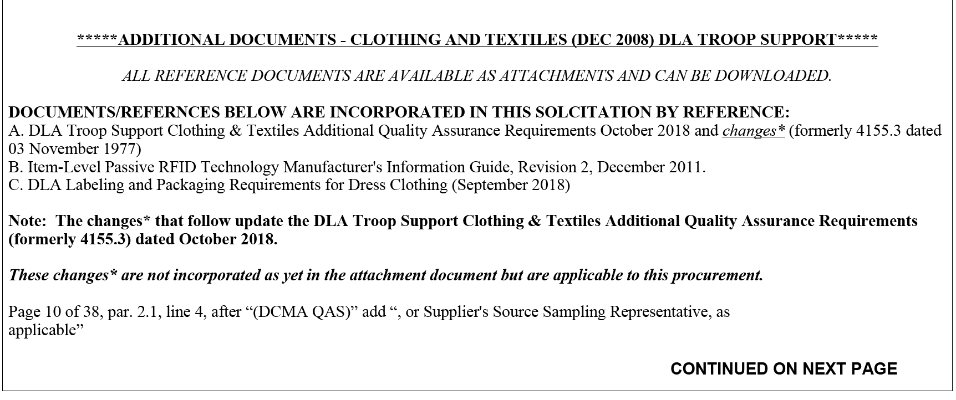
Contractual Obligation
Source:

Slide 16
Contractual Obligation
Old DLAD clause cancelled – could be found in Section I – Contract Clauses
E46C12 52.246-9032 IDENTIFICATION OF QUALIFIED LABORATORY AND SOURCE SAMPLING (NOV 2011) DLAD
Lab Certification Program (Lab Surveys)
(a) The offeror or bidder shall indicate in paragraph (e) below the name and address of the laboratory or laboratories where components or end items will be tested during the course of any resultant contract. Any laboratory proposed by the contractor is subject to the approval of the contracting officer.
Source:

Slide 17
Contractual Obligation
QAR Responsibilities and Correlation Testing
(b) The Government QAR will cut samples from a lot at the textile component source and send them for testing to the Laboratory cited below. (The acceptability of each lot will be determined through the testing of these samples). In addition, the QAR will simultaneously cut samples from the same rolls of material and send them to the DLA Troop Support laboratory when advised by the DLA Troop Support textile technologist to do so. For end items, duplicate samples will be drawn. Source sampling procedures are detailed further in the DLA Troop Support Clothing & Textiles Additional Quality Assurance Requirements dated October 2018 (formerly 4155.3, dated 03 November 1997), which is incorporated by reference.
Updates to AQAR permit the
Supplier’s Source Sampling Representative to cut samples.

Slide 18
Contractual Obligation
Notifications – to the DLA PTC
(c) The prime contractor will notify the DLA Troop Support textile technologist (__________ at (215) 737-____) in writing at least ten days in advance when lots are to be presented to allow Government witnessing of testing at the contractor’s laboratory. If the Government intends to witness testing, a representative from the DLA Troop Support laboratory will notify the contractor’s laboratory. In the absence of Government notification, testing should proceed as scheduled.
What if a lab cannot be approved and DLA needs the goods?
(d) Should the contracting officer withdraw approval of the laboratory proposed by the contractor during the course of a contract, DLA Troop Support will perform the required testing for up to 30 calendar days from the date of approval withdrawal. The charge for testing will be at the DLA Troop Support laboratory’s effective cost rate on the date of testing. The contractor is responsible for securing the services of another laboratory during this period.
Notes:
Note: In plain English, notifications are to go to the DLA Product Test Center – Analytical. We have either textile technologists or chemists assigned to each laboratory. Send notifications to paactlab@dla.mil. We will then assign that laboratory a lab specialist to handle test reports.

Slide 19
Who do notifications go to
In plain English, notifications are to go to the DLA Product Test Center – Analytical
We have either textile technologists or chemists assigned to each laboratory.
Send notifications to paactlab@dla.mil.
We will then assign that laboratory a lab specialist to handle test reports.
Please check your contracts to see if your vendors are being directed to send their reports to the PTC-A

Slide 20
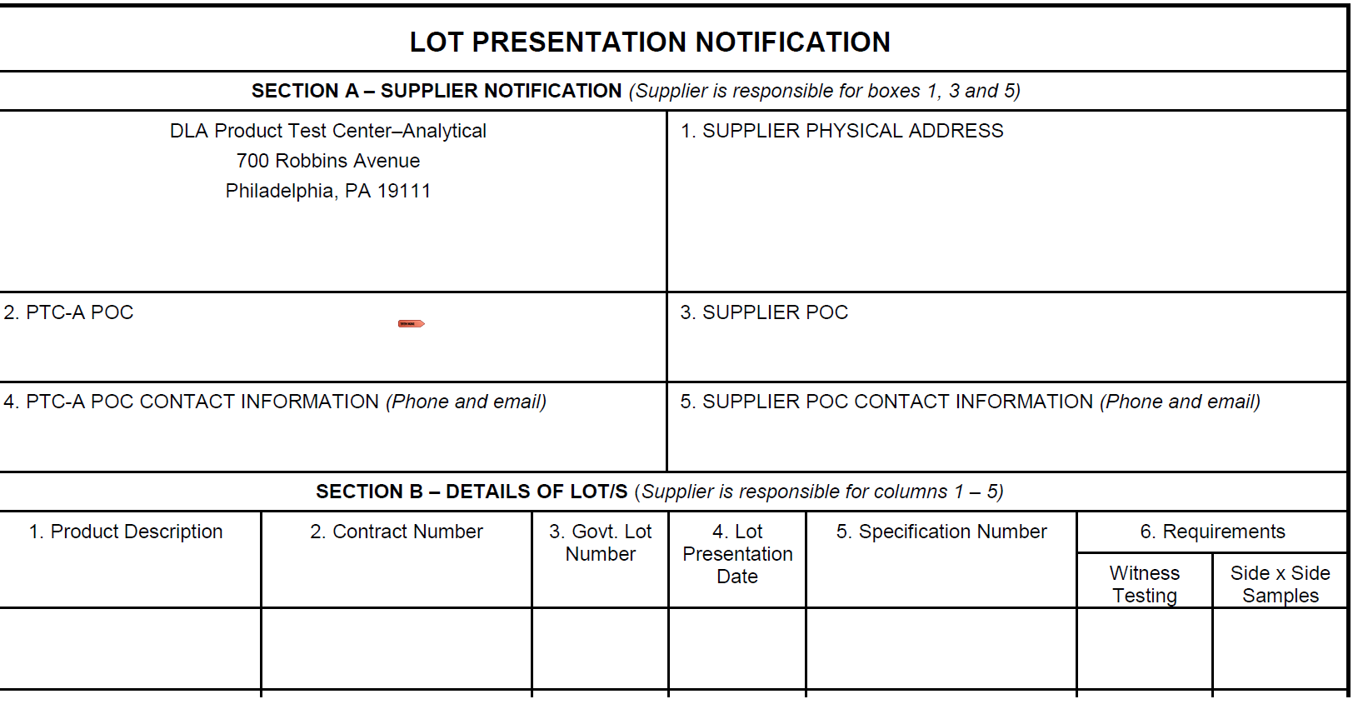
Notification of Lot Presentation
Minimum 14 calendar days before lot presentation.
No earlier than 30 calendar days before lot presentation.
Email preferred.
Notification sent to paactlab@dla.mil

Slide 21
SUNTEST: Source Sampling Untested
SSSR
selects samples
SSSR signs and dates DD1222
Within 90 days the test report is sent to the DLA PTC
Testing complete
PASS
PTC evaluates test report
Passing report + DD1222
filed on J: drive
FAIL
GOODS MAY SHIP
PTC generates DL6004
Failing report +
DL6004 to C&T
SSSR = supplier’s source sampling representative
DCMA involvement will be RARE

Slide 22
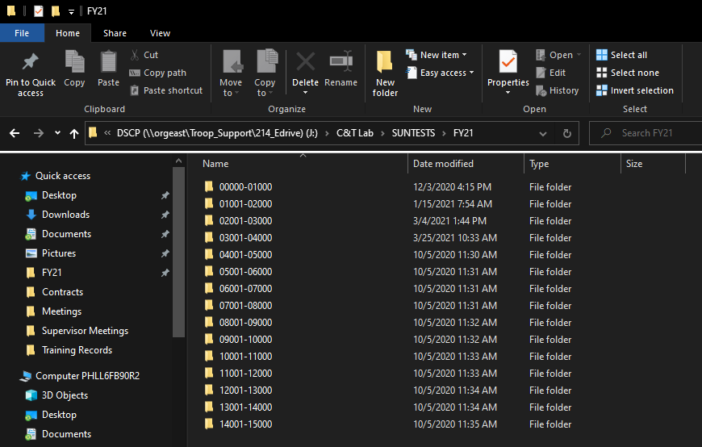
SUNTEST: Shared Drive Location
\\orgeast\Troop_Support\214_Edrive\C&T Lab\SUNTESTS

Slide 23
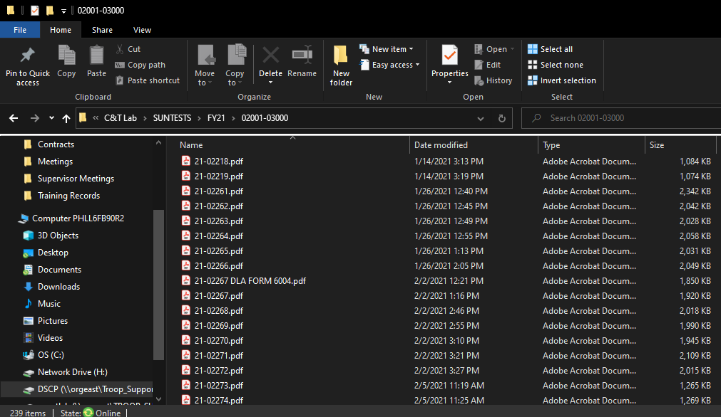
SUNTEST: Shared Drive Location
\\orgeast\Troop_Support\214_Edrive\C&T Lab\SUNTESTS
FAILING SUNTEST

Slide 24
How the PTC Evaluates Contractor Test Reports
Do we have the current tech data?
Is one color/pattern represented per DD1222?
Do the contract, lot, specification match?
Is it signed by a DCMA QAS or SSSR?
Is the fabric correct?
Are the listed tests correct?
Are the requirements correct?
Are the test methods correct?
Are the determinations correct?
Do all values pass?
FY 20 Failure Rate: 14.7%
FY21 Failure Rate: 9.9%

Slide 25
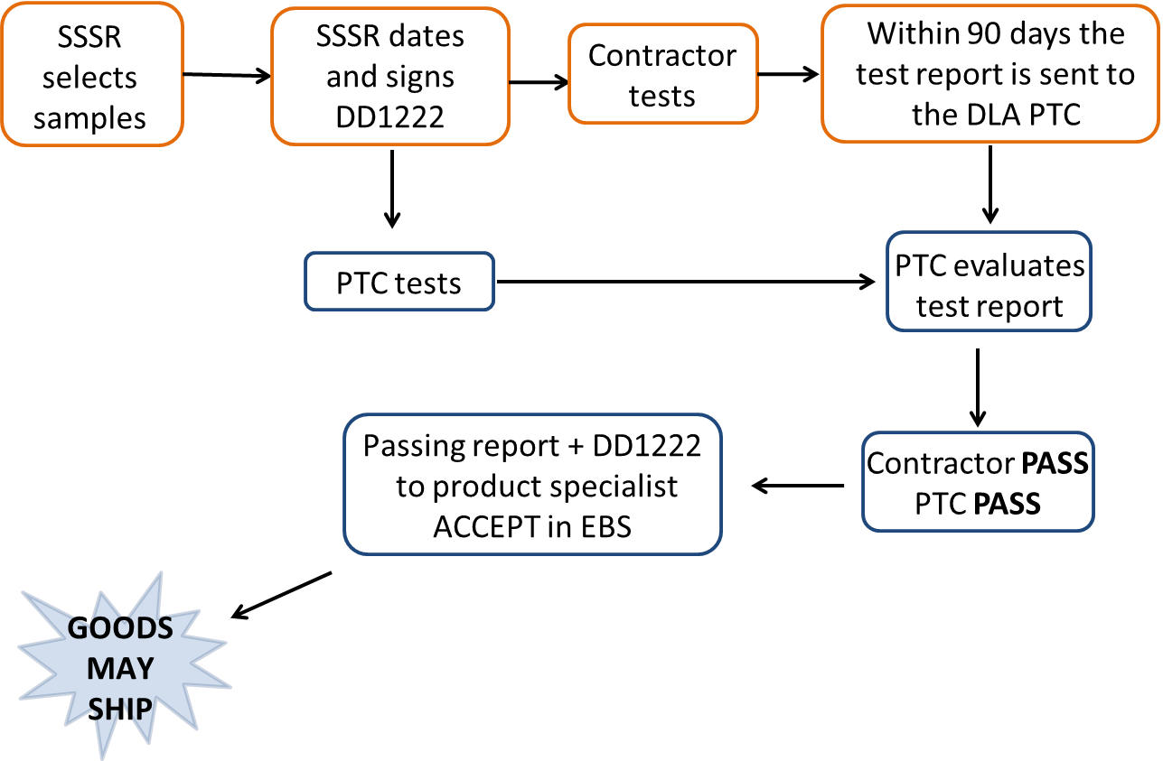
STEST: Source Sampling Tested

Slide 26
STEST: Source Sampling Tested
SSSR selects samples
SSSR signs and dates DD1222
Within 90 days the test report is sent to the DLA PTC
Contractor tests
PTC tests
PTC evaluates test report
PTC generates DL6004
Contractor PASS
PTC FAIL
GOODS MAY SHIP
Failing report +
DL6004 to C&T
for information ONLY
ACCEPT in EBS

Slide 27
STEST: Source Sampling Tested
SSSR selects samples
SSSR signs and dates DD1222
Within 90 days the test report is sent to the DLA PTC
Contractor tests
PTC tests
PTC evaluates test report
Contractor FAIL
PTC PASS
Contractor FAIL
PTC FAIL
Failing report +
DL6004 to C&T
REJECT in EBS
PTC generates DL6004

Slide 28
DL6004 and Failures
Summary of the pertinent information needed for a usage decision or corrective action.
DLA PTC will fill out Part I

Slide 29
Verification Testing
QAS/SSSR selects samples
QAS/SSSR signs then datesDD1222
Contractor tests
Contractor PASS/FAIL
PTC PASS
PTC tests
Passing report
to product specialist
ACCEPT in EBS
C&T evaluates test report

Slide 30
Verification Testing
QAS selects samples
QAS Signs then dates DD1222
Contractor tests
Contractor PASS/FAIL
PTC FAIL
PTC tests
Failing report
to product specialist REJECT in EBS
C&T generates DL6004
C&T evaluates test report

Slide 31
Summary
STest: Source Sampling Tested
Verification Testing
PTC requests material
PTC determines tests to perform
PTC evaluation is for guidance
Can ship at own risk whenever
PTC generates any DL6004s
Contractor’s report used for ACCEPT/REJECT
Product Specialist requests material
Product Specialist decides tests to perform – can test all or only specific characteristics
PTC evaluation is for acceptance
CANNOT SHIP until PTC results are in
Product Specialist generates any DL6004s
PTC’s report used for ACCEPT/REJECT

Slide 32
Government Furnished Material
Does GFM go through the same process?
Not really
AQAR 1.7 states:
Government Furnished Material (GFM) is material purchased and owned by the Government and is provided by the Government to a contractor for use in the performance of a contract.
A manufacturer who is producing the GFM for DLA must test their component as their material is CFM not GFM.
The manufacturer who is supplied with the GFM to create end items does not need to test the component, but will need to complete any end item testing. The contractor is however required to notify the Government if they suspect or have determined that the GFM provided is deficient.

Slide 33
Special Case: Leather
Unless otherwise specified, shall not exceed 25,000 sq ft
What is a lot?
From units of product of similar size and type
From functionally equivalent tanning and finishing materials
From a single production method
From sequential production batches
Sampling
Locations scattered throughout the lot
Without regard to quality
Select shade and physical samples from visual/dimensional samples
15 random 8 x 8 inch units
Questions?
FED STD 311

Slide 34
Real Life Examples
We have collected some real life examples of suppliers who have the AQAR in their contracts, have submitted shade samples but have not submitted any physical test reports, and the specification calls for testing. We are asking the contract team to contact the vendors and request they comply with the AQAR, and send in the physical test reports.
Hyman Brickle & Son INC. SPE1C1-20-D-1285
Beret contract against A-A-55184A
We have seen 15 shade lots, no test reports
Jensen Promotional Items INC. SPE1C1-20-D-1308
Beret contract against A-A-55184A
We have seen over 14 shade lots, no physical test reports
Notes:
All dress shirts have end item testing too, we have never seen a physical test report.

Slide 35
The Future
Currently the source program is reliant on a “paper-based” system using email and faxed submittals using various electronic formats or hand-written forms. Current processes also rely on manual review and sign off steps.
New technologies offer great efficiencies for suppliers, labs, and PTC to automate procedures, enabling consistent data forms and reports.
DLA is adapting a commercially available technology for our needs, transitioning from a manual review process to an electronic, data driven process.
This effort will enable DLA Troop Support to:
strengthen its partnership and communication with the Clothing & Textile industrial base, and
increase the visibility of material and end item quality requirements.
As a result, DLA Troop Support and its industrial base will increase its capability to deliver the highest quality clothing and individual equipment items to the warfighter.
Notes:
Technology has moved forward and like technology we must also move forward. 15 years ago we still used typed DD1222’s and snail mail, in 2004 we moved to email distribution, ad electronic processing,. We are now looking to move to an online submission portal.

Slide 36
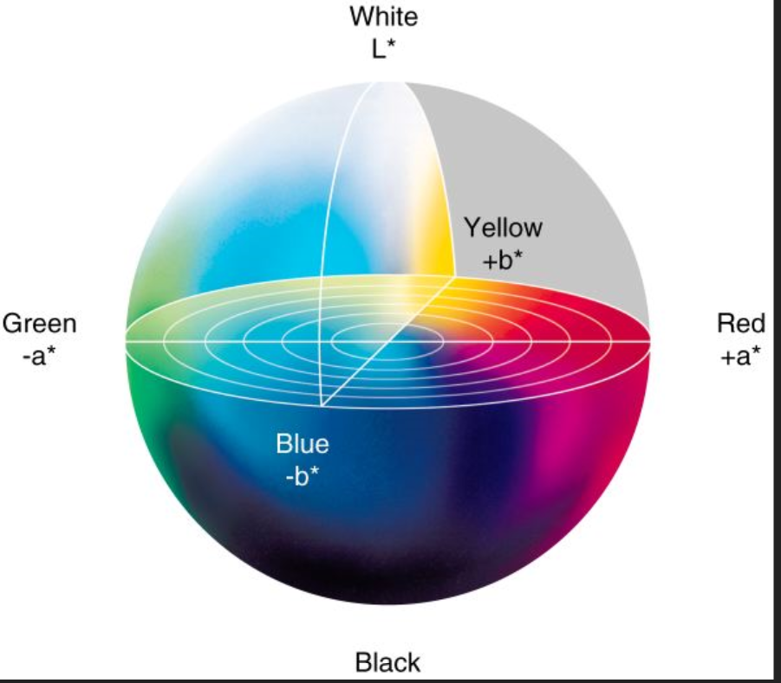
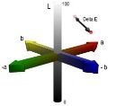
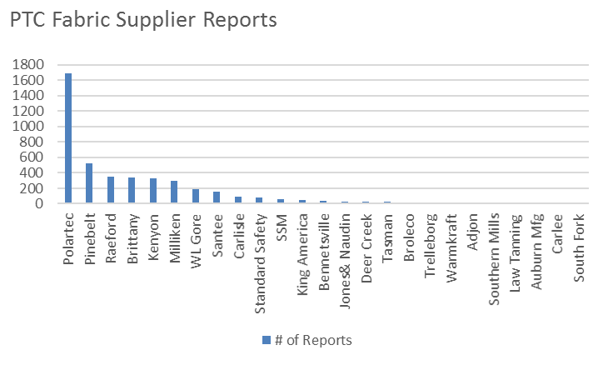
Product Test Center — Analytical
Recent Annual Statistics
~ 15K Test Reports /year
Collaborative Partners: LMI, Texbase, Natific, Major Fabric Suppliers
DLA Sponsor: DLA MUST Program and DLA Product Test Center - Analytical
~10K Shade
~5K Source/Correlation/ Verification Testing
>4K Fabric
< 1K Other
Benefits:
Automated identification of non-conforming material
Standardized process and formats for test result submittal
Higher quality C&T products for the warfighter
Technical Approach:
Reengineer processes, develop protocols
Leverage/validate adopted commercial procedures for proper communication and management of product test data
Identify, tailor and validate COTS software for PTC application
Purpose:
Reengineer and automate manufacturers’ source production lot test reporting
Streamline DLA PTC review and analysis of test results
Notes:
In the last five years we have seen growth in our work on shade and physical testing, to continue to move our process to a more automated system makes sense.

Slide 37
Description of Automated Solution
The Product Test Center has embarked on a modernization program to streamline processes and update its systems to maintain the quality control of materials used to construct clothing and equipment for today’s warfighter.
The MUST Source Sampling Tool is a commercially available textile testing and supplier collaboration system that has been modified to meet the specific workflow requirements of the DLA supply chain.
The MUST Source Sampling Tool merges Prime Contractors, Material Suppliers and Independent Testing Labs into one standardized system.
Notes:
The companies we are working with has may years of experience, and a COTS system that will work, with some modifications. Will allow the PTC to streamline the lot notification process, it will automatically generated DD1222’s, electronic sign off capability, ad the system has taken into account the potential loss of DCMA QARS into consideration. The system will automatically notify the PTC when reports are ready, we see this as both a work and time saver.

Slide 38
Intro to Source Sampling Tool
Easy to use browser-based system (no software to install)
Benefits include:
Standardized workflow
Standardized testing procedures
Digitizing data
Automated notification and PTC response of source lot testing date/enforcement of 14 day waiting period
Visibility to current testing requirements
Automatic evaluation of test results versus test requirements
Ability to re-use previously entered data
Automated creation and archiving of standard DD1222
Automated event notifications for all members of the supply chain
Notes:
Our goal is to have an easy user driven system that expedites the source sampling process.

Slide 39
Challenges to Overcome
Resistance to change
Current DLA process is inefficient and needs to change
Suppliers individually optimized
Fear of the unknown
Education on the use of the tool
Dual Entry
Understand how the tool works and see how it can reduce the work currently being done
Concern for increased oversight
Streamlined processes equate to reduced costs and increased quality
Notes:
We have become comfortable even if at times frustrated with the current system. Change is difficult, as we move into the process active participation will help quell fears, and provide better understanding. We are looking to increase speed of processing, not level of oversite.

Slide 40
Source Sampling Tool Roll-Out
Continue Final Phase of Development
On-board fabric suppliers in phases to submit all fabric reports through the system
Focus on high volume fabric suppliers
When on-boarding the fabric suppliers, include their associated primes
Considerations for timing supplier on-boarding
Past engagement with Source Sampling Tool User Eval
Past engagement with R&D/PTC efforts
Stability
PTC will contact participants prior to on-boarding coordination
Notes:
Do not be alarmed, if you are part of the initial rollout the PTC will contact you. We’d like you to know this is coming, and will update the entire system

Slide 41
PTC POC’s
Jamie Hieber
Lab Manager
Jamie.Hieber@dla.mil
215-737-3241 (Office)
215-687-7037 (Work Cell)
Jessica Raushel
Supervisory Chemist
Jessica.Raushel@dla.mil
215-737-3246 (Office)
267-236-3779 ( Work Cell)
Uraina Gray-Scully
Supervisory Chemist
Uraina.Gray-scully@dla.mil
215-737-3265 (Office)
(267) 990-4093 (Work Cell)
Myriam Cuadra
Test Coordinator
Myriam.Cuadra@dla.mil
215-737-3298 (Office)

Slide 42
Questions?

